Slide 1
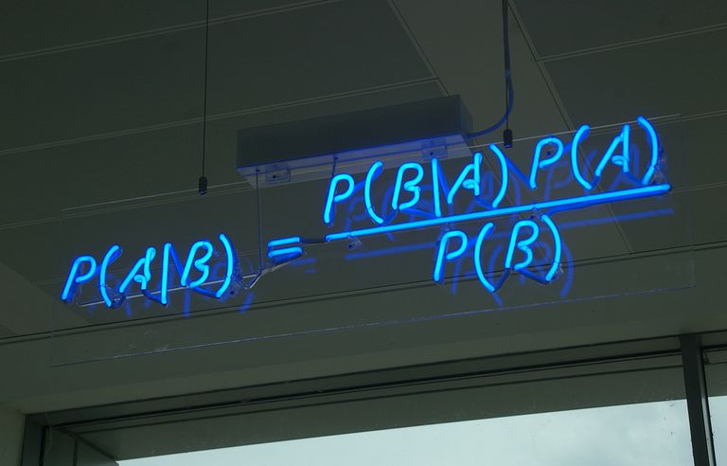
NAIVE BAYES
CLASSIFIER
Notes:
Nhớ mở app stopwatch để canh giờ

Slide 2
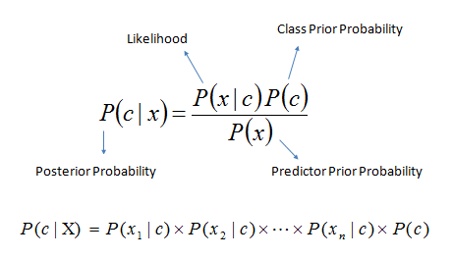
Algorithms

Slide 3
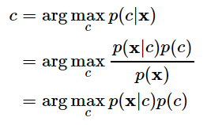

Estimating the parameters
With:
Note: p(c) can be calculated using MLE or MPA estimation, the first is commonly used.

Slide 4
Variations
Multinomial Naive Bayes:
Mostly used for document classification problem, i.e whether a document belongs to the category of sports, politics, technology etc. The features/predictors used by the classifier are the frequency of the words present in the document.
Bernoulli Naive Bayes:
This is similar to the multinomial naive bayes but the predictors are boolean variables. The parameters that we use to predict the class variable take up only values yes or no, for example if a word occurs in the text or not.
Gaussian Naive Bayes:
When the predictors take up a continuous value and are not discrete, we assume that these values are sampled from a gaussian distribution.

Slide 5
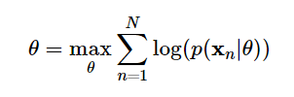
Loss function
Maximum Log-likelihood or Negative Log-likelihood

Slide 6
Overfitting
When: Not likely, if properly implemented.
To avoid overfitting:
Use k-fold cross validation
Have a validation dataset

Slide 7
References:
https://towardsdatascience.com/naive-bayes-classifier-81d512f50a7c
https://machinelearningcoban.com/2017/08/08/nbc/
https://machinelearningcoban.com/2017/07/17/mlemap/#-maximum-likelihood-estimation
https://www.slideshare.net/ananth/an-overview-of-nave-bayes-classifier
https://www.saedsayad.com/naive_bayesian.htm
https://stackoverflow.com/questions/25583591/loss-risk-function-for-sci-kit-learns-naive-bayes-classifier
https://stats.stackexchange.com/questions/296014/why-is-the-naive-bayes-classifier-optimal-for-0-1-loss
https://stats.stackexchange.com/questions/141087/i-am-wondering-why-we-use-negative-log-likelihood-sometimes
https://www.quora.com/Why-are-Naive-Bayes-classifiers-considered-relatively-immune-to-overfitting
https://medium.com/@vibhuti.siddhpura/machine-learning-algorithms-introduction-fb86623c5218

